Slide 1
LGIT-Universal Lens Cal. SYSTEM

Slide 2
Contents
기구부
전장부

Slide 3
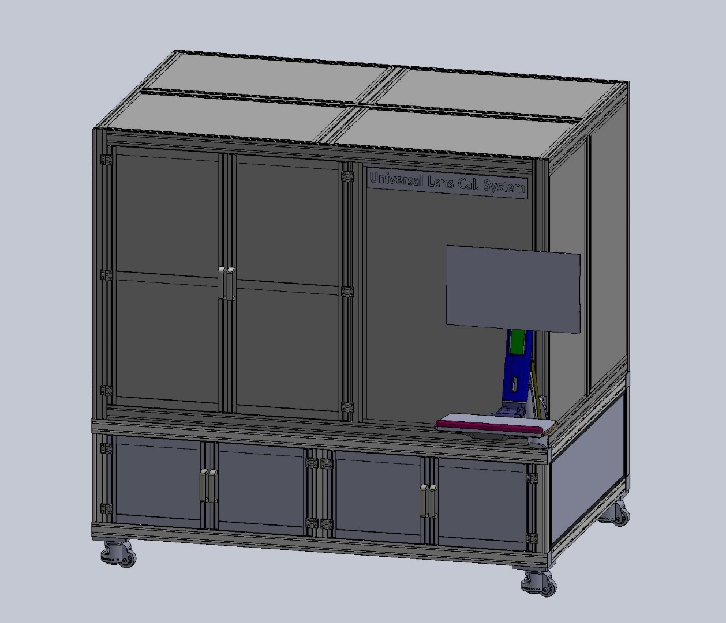
기구부
Equipment Size
Length | Door Closed | 1850 mm
 | Door Open | 2290 mm
Deep | Door Closed | 1250 mm
 | Door Open 1 | 1750 mm
 | Door Open 2 | 2260 mm
Hight |  | 1780 mm

Slide 4
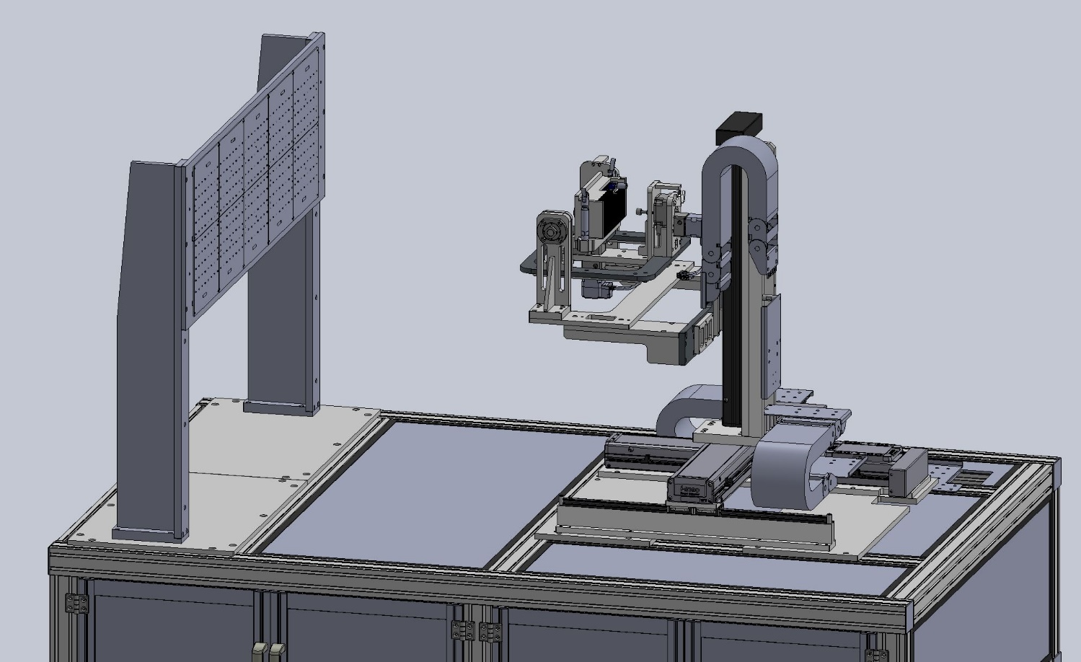
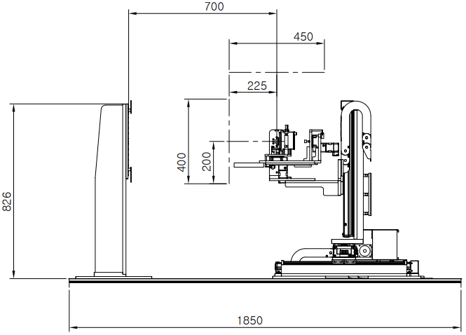
기구부
Layout

Slide 5
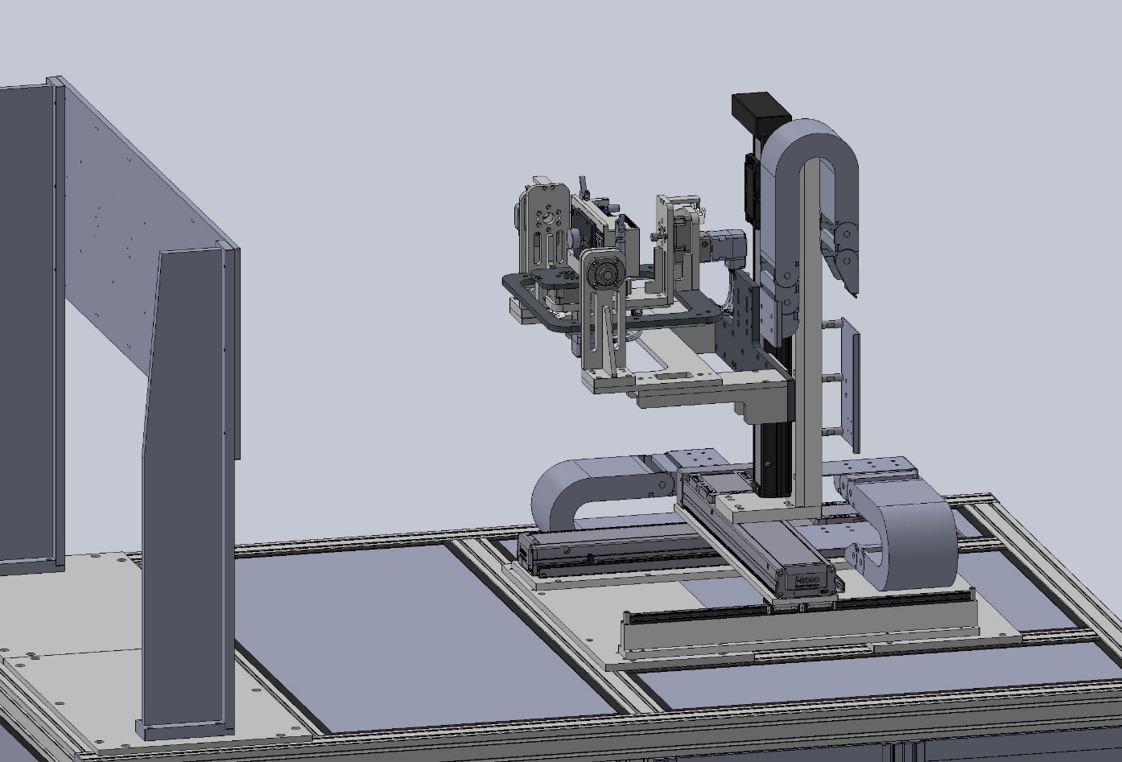
기구부
Equipment X, Y, Z Stage
Z Stage | I-ROBO SAN10008-450PL+3SL
 | Stroke : 450 mm (± 225 mm)
 | Lead : 5mm
 | Motor : EZM-60L
 | Pulley type (1:1)
 | WD : 700mm ±225mm
Y Stage | i-ROBO SAN7005H-400PR+3SL
 | Stroke : 400mm (± 200 mm)
 | Lead : 5mm
 | Motor : EZM-60L-Brake type
 | Pulley type (1:1)
X Stage | i-ROBO SAN10005-400PL+3SL
 | Stroke : 400mm (± 200 mm)
 | Lead : 5mm
 | Motor : EZM-60L
 | Pulley type (1:1)
Motion (X, Y, Z)

Slide 6
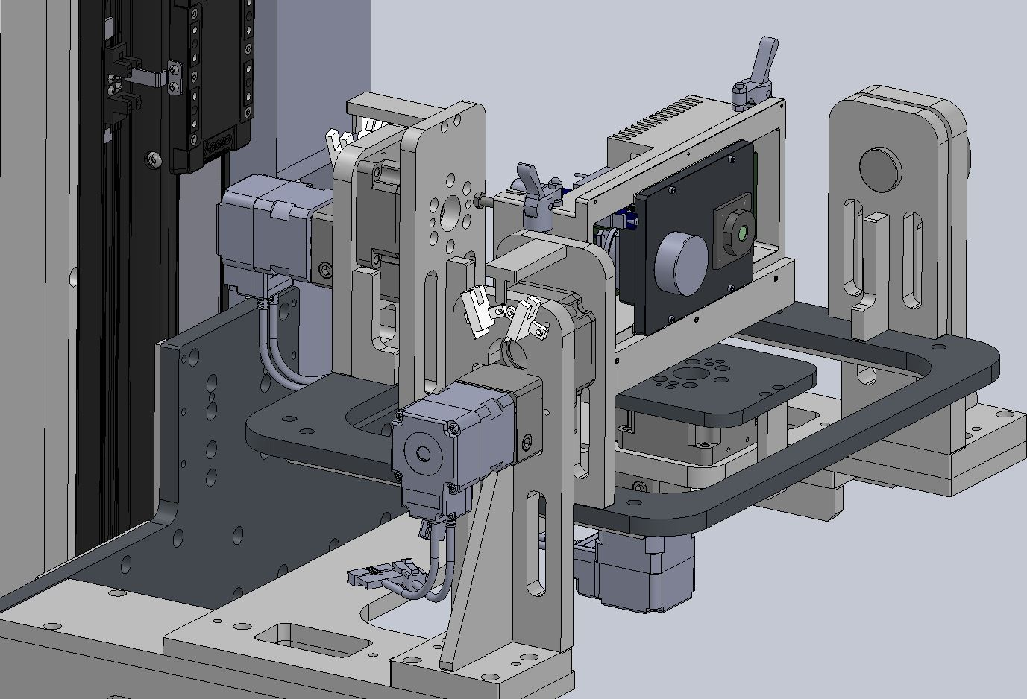
기구부
Equipment Stage
Ry Stage | Reducer : KGT60-B-18
 | Stroke : ± 20°
 | Reducer ratio : 18 / 1
 | Motor : EZM-42S
 | Sensor
Rx Stage | Reducer : KGT60-B-50
 | Stroke : ± 20°
 | Reducer ratio : 50 / 1
 | Motor : EZM-42M-Brake type
 | Sensor
Rz Stage | Reducer : KGT60-B-18
 | Stroke : ± 30°
 | Reducer ratio : 18 / 1
 | Motor : EZM-42S
 | Sensor
Motion (Rx, Ry, Rz)

Slide 7
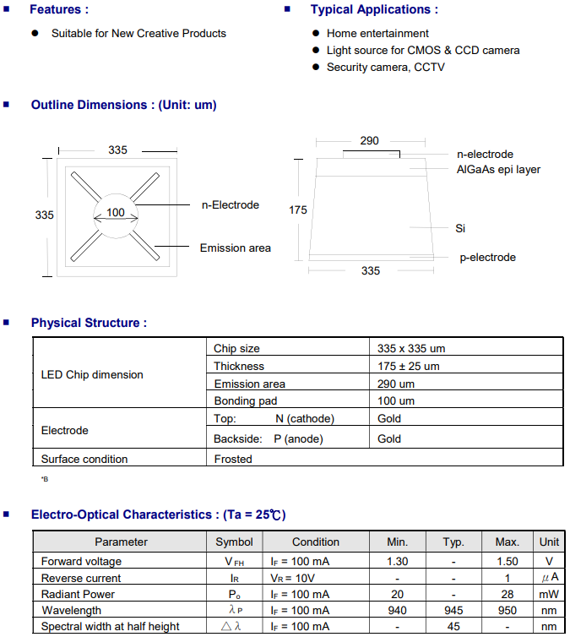
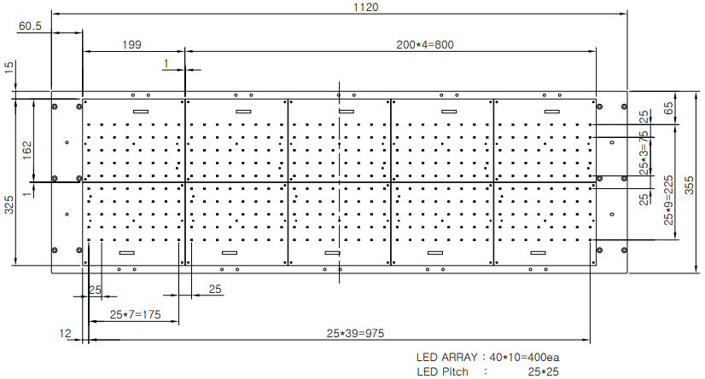
기구부
LED 배열 및 사양

Slide 8
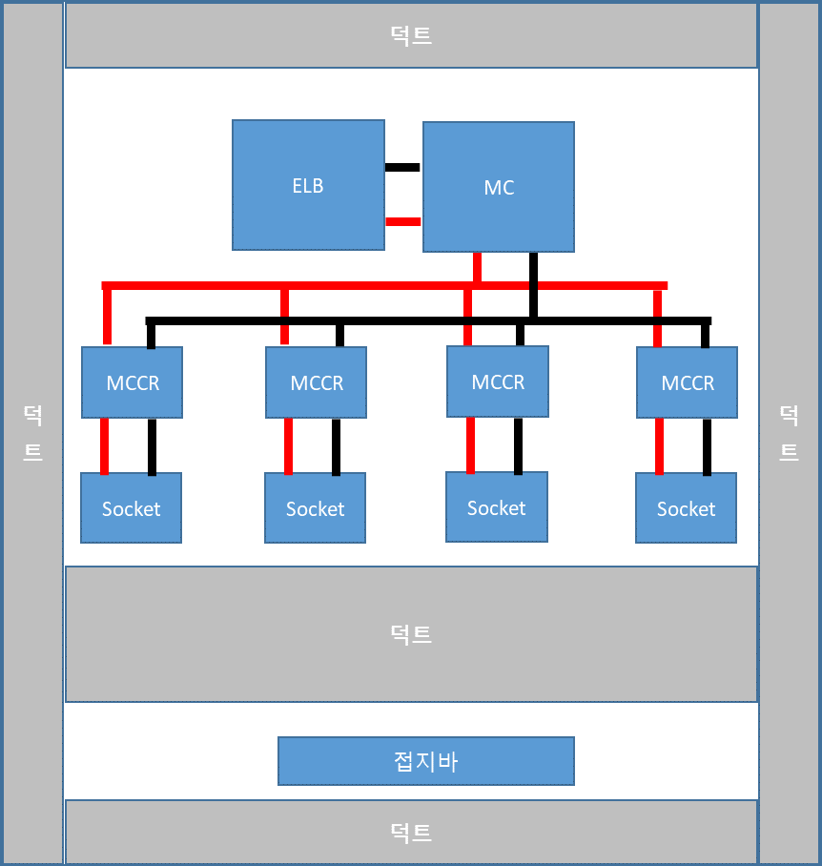
전장부
Layout
XY Calibration Chart 최대 소비전력 및 부하
No. | 파트 | 최대소비전력(W) | 최대소비전류(A) | 수량 | 최대소비전력(W) | 최대소비전류(A) | 기타
1 | Motion Controller | 610 | 2.77 | 1 | 610.0 | 2.77
2 | Controller board | 253 | 1.15 | 1 | 253.0 | 1.15
3 | 산업용PC | 900 | 4.09 | 1 | 900.0 | 4.09
4 | Monitor | 220 | 1.00 | 1 | 220.0 | 1.00
5 | 485 컨버터 아답터 | 30 | 0.14 | 1 | 30.0 | 0.14
6 | LED LAMP | 10 | 0.05 | 1 | 10.0 | 0.05
7 | DC Fan 아답터 | 330 | 1.50 | 1 | 330.0 | 1.50
 | TOTAL |  |  |  | 2353.0 | 10.70

Slide 9
THANK YOU
for your attention!

